Slide 1
Chapter 9
Architectural Design

Slide 2
Why Architecture?
The architecture is not the operational software. Rather, it is a representation that enables a software engineer to:
(1) analyze the effectiveness of the design in meeting its stated requirements,
(2) consider architectural alternatives at a stage when making design changes is still relatively easy, and
(3) reduce the risks associated with the construction of the software.

Slide 3
Why is Architecture Important?
Representations of software architecture are an enabler for communication between all parties (stakeholders) interested in the development of a computer-based system.
The architecture highlights early design decisions that will have a profound impact on all software engineering work that follows and, as important, on the ultimate success of the system as an operational entity.
Architecture “constitutes a relatively small, intellectually graspable mode of how the system is structured and how its components work together” [BAS03].

Slide 4
Architectural Descriptions
The IEEE Computer Society has proposed IEEE-Std-1471-2000, Recommended Practice for Architectural Description of Software-Intensive System, [IEE00]
  to establish a conceptual framework and vocabulary for use during the design of software architecture,
  to provide detailed guidelines for representing an architectural description, and
  to encourage sound architectural design practices.
The IEEE Standard defines an architectural description (AD) as a “a collection of products to document an architecture.”
  The description itself is represented using multiple views, where each view is “a representation of a whole system from the perspective of a related set of [stakeholder] concerns.”

Slide 5
Architectural Genres
Genre implies a specific category within the overall software domain.
Within each category, you encounter a number of subcategories.
  For example, within the genre of buildings, you would encounter the following general styles: houses, condos, apartment buildings, office buildings, industrial building, warehouses, and so on.
  Within each general style, more specific styles might apply. Each style would have a structure that can be described using a set of predictable patterns.

Slide 6
Architectural Styles
Each style describes a system category that encompasses: (1) a set of components (e.g., a database, computational modules) that perform a function required by a system, (2) a set of connectors that enable “communication, coordination and cooperation” among components, (3) constraints that define how components can be integrated to form the system, and (4) semantic models that enable a designer to understand the overall properties of a system by analyzing the known properties of its constituent parts.
Data-centered architectures
Data flow architectures
Call and return architectures
Object-oriented architectures
Layered architectures

Slide 7
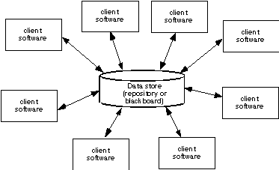
Data-Centered Architecture

Slide 8
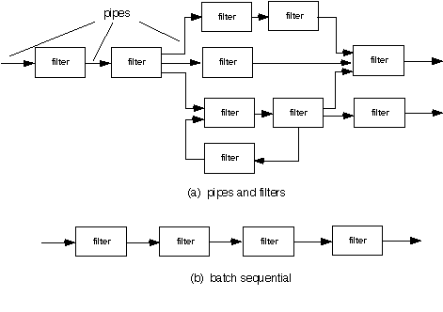
Data Flow Architecture

Slide 9
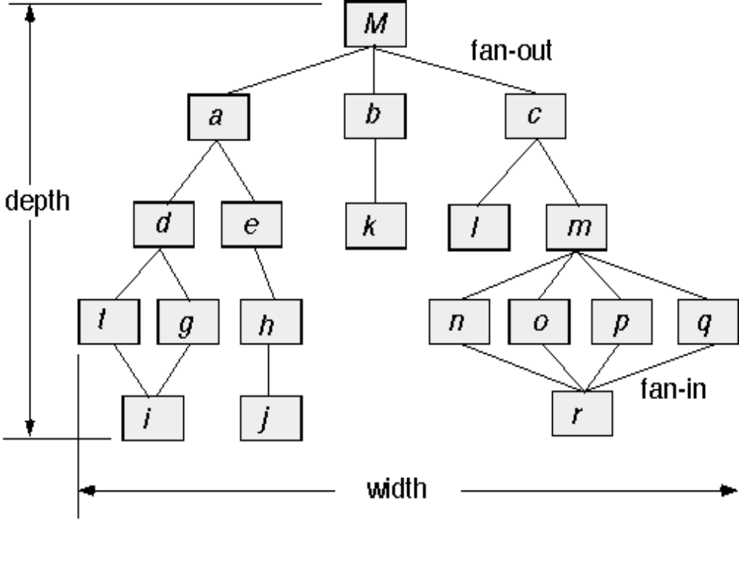
Call and Return Architecture

Slide 10
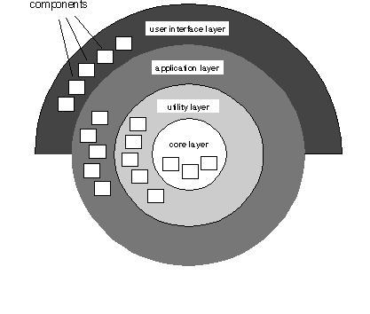
Layered Architecture

Slide 11
Architectural Patterns
Concurrency—applications must handle multiple tasks in a manner that simulates parallelism
  operating system process management pattern
  task scheduler pattern
Persistence—Data persists if it survives past the execution of the process that created it. Two patterns are common:
  a database management system pattern that applies the storage and retrieval capability of a DBMS to the application architecture
  an application level persistence pattern that builds persistence features into the application architecture
Distribution— the manner in which systems or components within systems communicate with one another in a distributed environment
  A broker acts as a ‘middle-man’ between the client component and a server component.

Slide 12
Architectural Design
The software must be placed into context
  the design should define the external entities (other systems, devices, people) that the software interacts with and the nature of the interaction
A set of architectural archetypes should be identified
  An archetype is an abstraction (similar to a class) that represents one element of system behavior
The designer specifies the structure of the system by defining and refining software components that implement each archetype

Slide 13
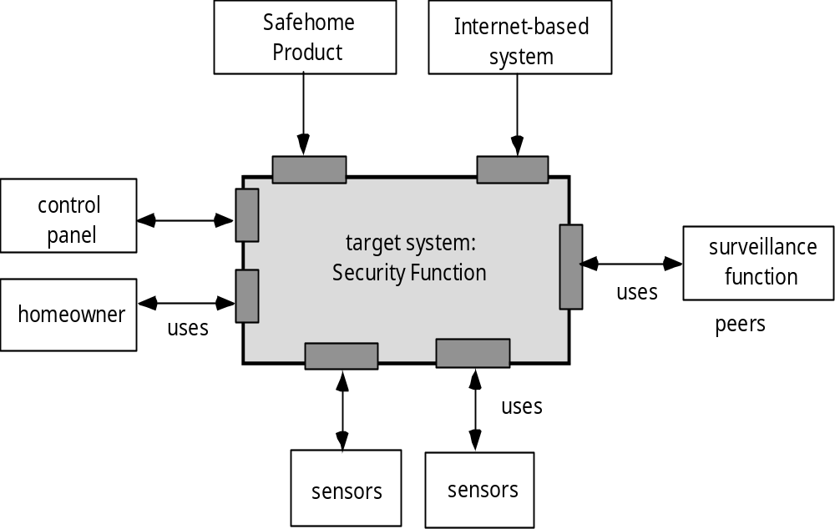
Architectural Context

Slide 14
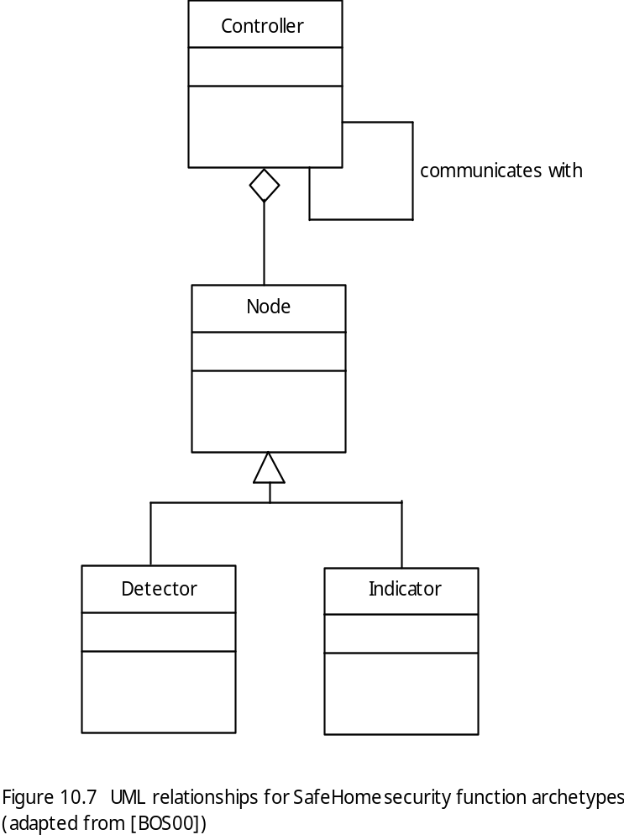
Archetypes

Slide 15
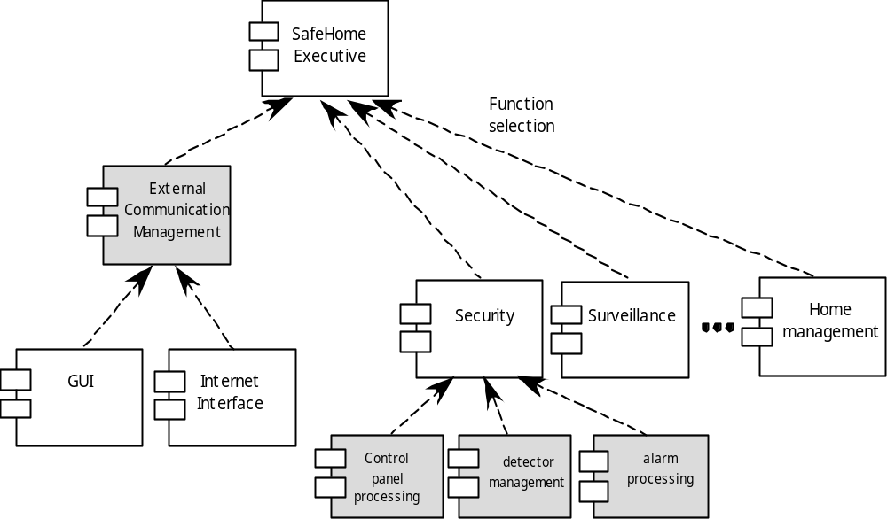
Component Structure

Slide 16
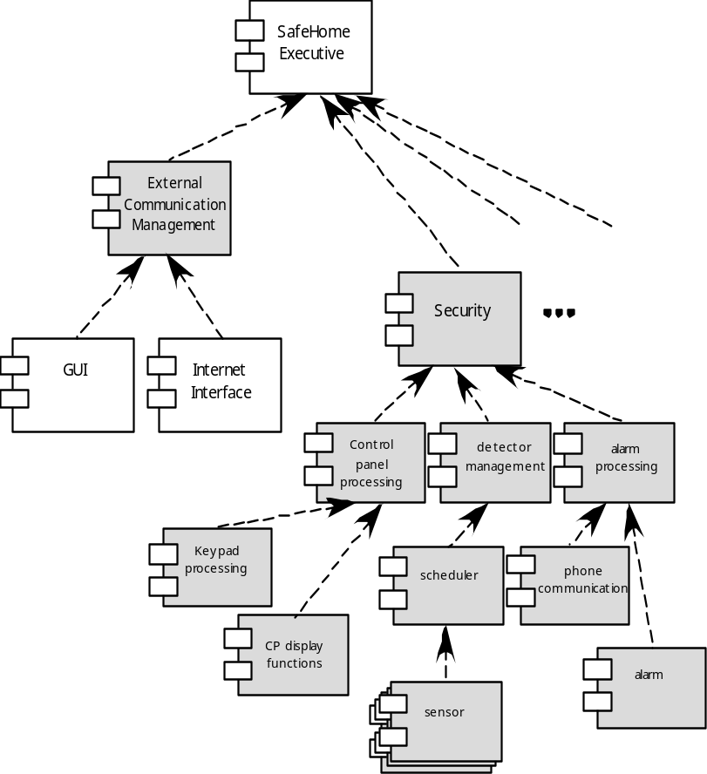
Refined Component Structure

Slide 17
Analyzing Architectural Design
1. Collect scenarios.
2. Elicit requirements, constraints, and environment description.
3. Describe the architectural styles/patterns that have been chosen to address the scenarios and requirements:
• module view
• process view
• data flow view
4. Evaluate quality attributes by considered each attribute in isolation.
5. Identify the sensitivity of quality attributes to various architectural attributes for a specific architectural style.
6. Critique candidate architectures (developed in step 3) using the sensitivity analysis conducted in step 5.

Slide 18
Architectural Complexity
the overall complexity of a proposed architecture is assessed by considering the dependencies between components within the architecture [Zha98]
  Sharing dependencies represent dependence relationships among consumers who use the same resource or producers who produce for the same consumers.
  Flow dependencies represent dependence relationships between producers and consumers of resources.
  Constrained dependencies represent constraints on the relative flow of control among a set of activities.

Slide 19
ADL
Architectural description language (ADL) provides a semantics and syntax for describing a software architecture
Provide the designer with the ability to:
  decompose architectural components
  compose individual components into larger architectural blocks and
  represent interfaces (connection mechanisms) between components.

Slide 20
An Architectural Design Method
customer requirements
"four bedrooms, three baths,
lots of glass ..."
architectural design

Slide 21
Deriving Program Architecture
Program
Architecture

Slide 22
Partitioning the Architecture
“horizontal” and “vertical” partitioning are required

Slide 23
Horizontal Partitioning
define separate branches of the module hierarchy for each major function
use control modules to coordinate communication between functions
function 1
function 3
function 2

Slide 24
Vertical Partitioning: Factoring
design so that decision making and work are stratified
decision making modules should reside at the top of the architecture
decision-makers
workers

Slide 25
Why Partitioned Architecture?
results in software that is easier to test
leads to software that is easier to maintain
results in propagation of fewer side effects
results in software that is easier to extend

Slide 26
Structured Design
objective: to derive a program architecture that is partitioned
approach:
  a DFD is mapped into a program architecture
  the PSPEC and STD are used to indicate the content of each module
notation: structure chart

Slide 27
Flow Characteristics
Transform flow
This edition of SEPA does not cover transaction mapping. For a detailed discussion see the SEPA website
Transaction
flow

Slide 28
General Mapping Approach
isolate incoming and outgoing flow
boundaries; for transaction flows, isolate
the transaction center
working from the boundary outward, map
DFD transforms into corresponding modules
add control modules as required
refine the resultant program structure
using effective modularity concepts

Slide 29
General Mapping Approach
Isolate the transform center by specifying incoming and outgoing flow boundaries
Perform "first-level factoring.”
  The program architecture derived using this mapping results in a top-down distribution of control.
  Factoring leads to a program structure in which top-level components perform decision-making and low-level components perform most input, computation, and output work.
  Middle-level components perform some control and do moderate amounts of work.
Perform "second-level factoring."

Slide 30
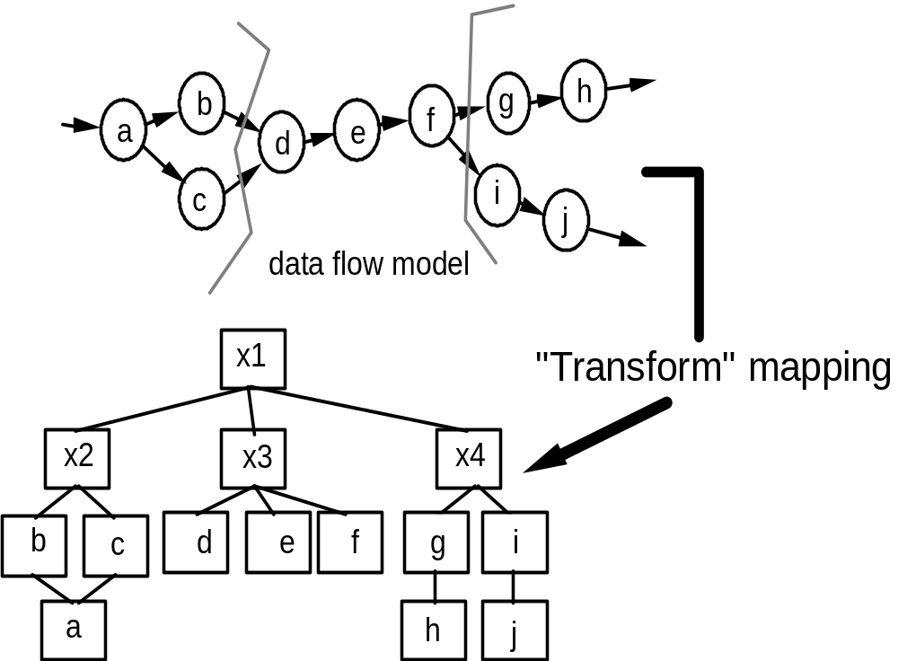
Transform Mapping

Slide 31
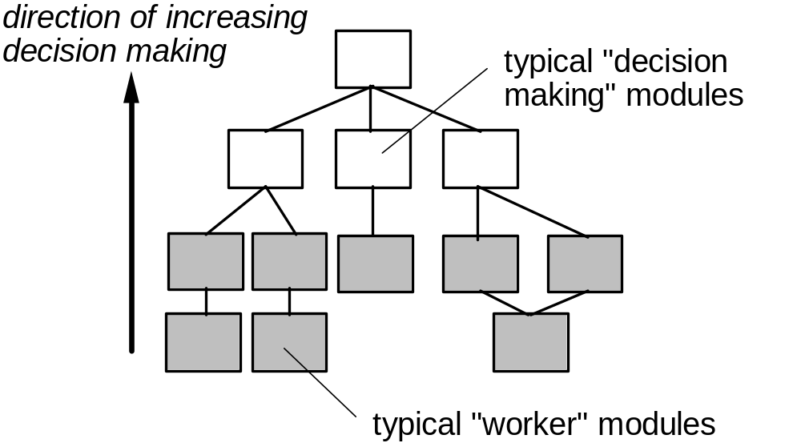
Factoring

Slide 32
First Level Factoring
main
program
controller
input
processing
output
controller
controller
controller

Slide 33
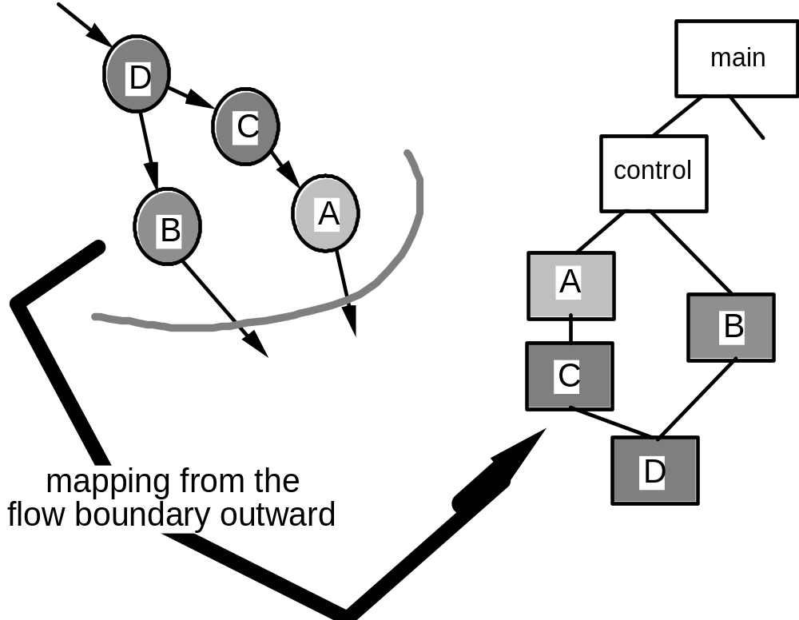
Second Level Mapping

